Slide 1


Slide 2


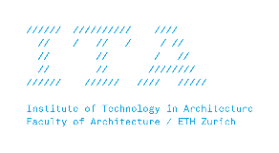


MAS Digital Fabrication
Hello World
Hello World, The Python Edition

Slide 3
What is an algorithm?

Slide 4
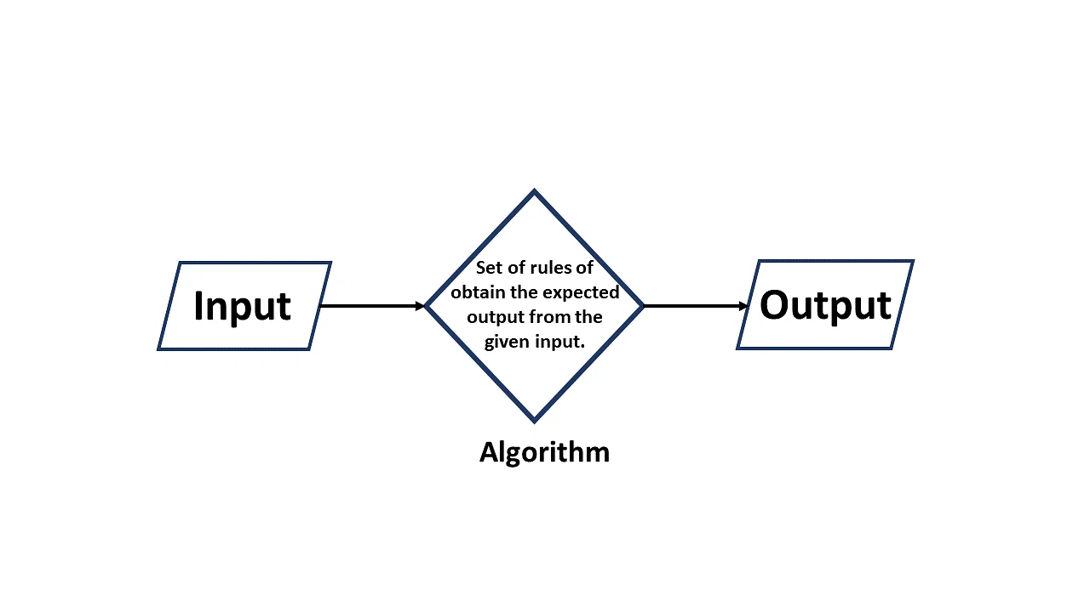

Slide 5
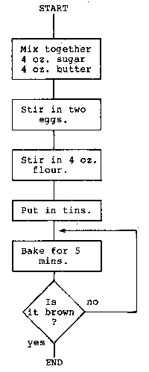
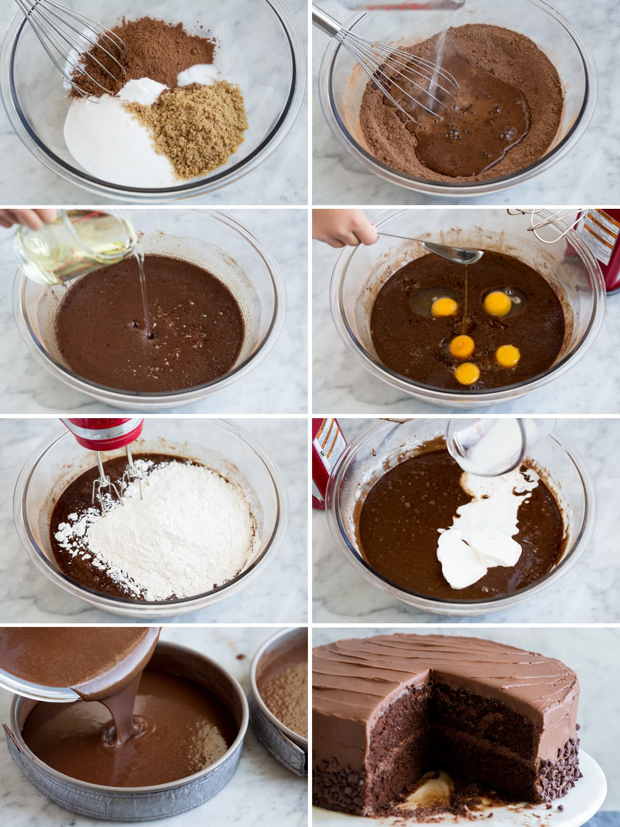
Fun content :https://esolangs.org/wiki/Chef

Slide 6
Object-Oriented Programming (OOP) is a programming paradigm based on the concept of "objects", which can contain data and code. The data is in the form of fields (often known as attributes or properties), and the code is in the form of procedures (often known as methods).

Slide 7
Significant object-oriented languages include: C++, Common Lisp, C#, Fortran 2003, Java, JavaScript, Kotlin, logo, MATLAB, Objective-C, Perl, PHP, Python, R, Raku, Ruby, Scala, SIMSCRIPT, Simula and Visual Basic.NET.

Slide 8
What is Python?
Python is a high-level, general-purpose programming language. Its design philosophy emphasizes code readability with the use of significant indentation.

Slide 9
print("code running on this line")
print("new line so new command")
New line

Slide 10
a = 3
if a == 3:
print("a is 3")
else:
print("a is not 3")
Indentation (whitespace) to define scope

Slide 11
functions, methods, variables, data types, classes, objects, libraries, modules, package, expression, boolean, operators, conditions, iteration, recursion, indentation, namespace, exception, comments, debugging, mutable, argument, iteration, nesting, lambda, index, dictionary
…

Slide 12
basic code flow
operators and expressions
sequences

Slide 13
1 #What is this? This is a comment. It is not executed by the computer.
2 #This is a comment. It is not executed by the computer.
3 my_text = "Hello World!"
4 print(my_text)#Using python’s inbuilt print function!
5 #Anything after the # is ignored by python.
6 #You can also see this in the color of the text.
Notes:
Live coding!

Slide 14
what is data and what are data types?

Slide 15
In the context of computer programming and computer science, "data" refers to the information that is processed, stored, or transmitted by a computer. Data can take various forms, such as numbers, characters, symbols, or more complex structures. Data types provide a way to classify and define how data should be interpreted and manipulated by a program.

Slide 16
int
float
Primitive
string
Built In
boolean
Python Data Types
lists, tuples
dictionary
Derived
string
set
Classes
User Defined
Objects

Slide 17
iteration and loops
functions
libraries(and other stories)

Slide 18
what is iteration?

Slide 19
Iteration and looping are fundamental concepts in programming that allow you to perform repetitive tasks efficiently. Iteration refers to the process of executing a block of code repeatedly, typically with varying input values or conditions. Looping is a control structure that enables this iterative behavior.

Slide 20
Stir cake batter
NO
Is it smooth?
YES
Let’s bake!
What part is the iteration here?

Slide 21
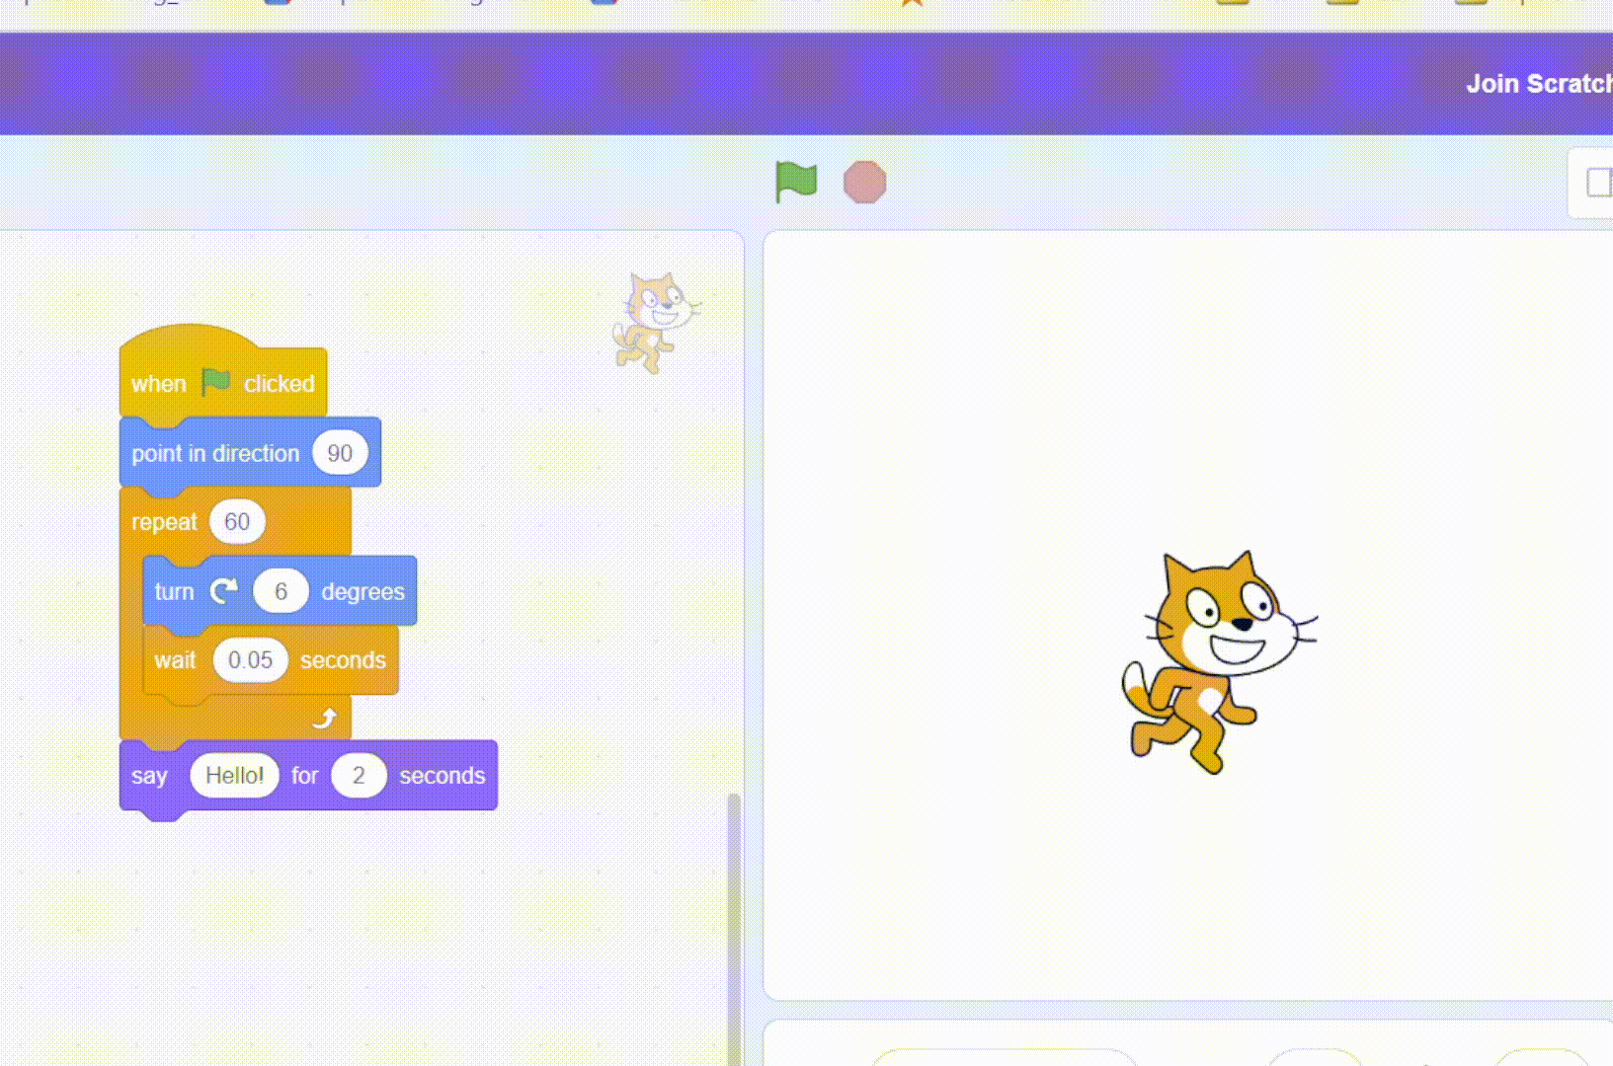
What part is the iteration here?

Slide 22
what is nesting/nested (in) data structures?

Slide 23
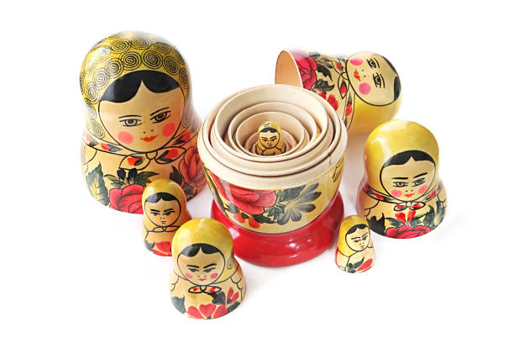
Nesting is basically data inside data

Slide 24
A nested structure represents data inside data. This can be quite useful to store complex data with hierarchies and structure. In Python, this can be a list within a list or a dictionary within a dictionary, and all such possible combinations.

Slide 25

ChatGPT works very well with coding problems. It is important you get a good understanding of coding before using this tool.

Slide 26
exercise : create a circle using ASCII characters!

Slide 27


